Slide 1
(Lecture-1) INT-402(MODERN WEB PROGRAMMING TOOLS AND TECHNIQUES)
Prepared By:
Palvi Soni

Slide 2
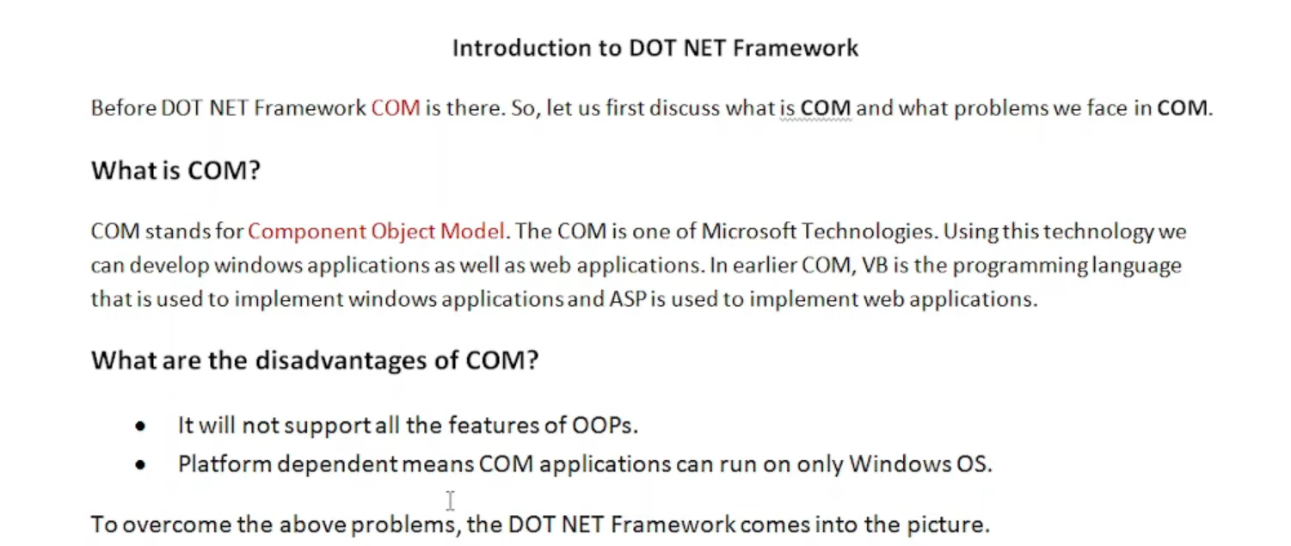
INTRODUCTION TO .NET FRAMEWORK

Slide 3


Slide 4
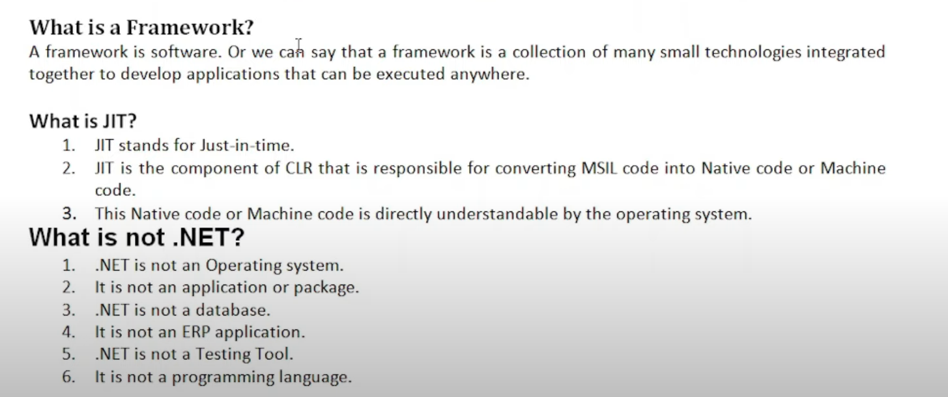

Slide 5
What is .NET?
NET is a free, cross-platform, open source developer platform for building many different types of applications.
With .NET, you can use multiple languages, editors, and libraries to build for web, mobile, desktop, games, IoT, and more.
Formally, .NET is “an open source developer platform, created by Microsoft, for building many different types of applications. You can write .NET apps in C#, F#, Visual C++, or Visual Basic.”
Informally, .NET is the tool that lets you build and run C# programs

Slide 6
How .net programs can help you?
When you download .NET, you’re really downloading a bunch of programs that:
Translate your C# code into instructions that a computer can understand
Provide utilities for building software, like tools for printing text to the screen and finding the current time
Define a set of data types that make it easier for you to store information in your programs, like text, numbers, and dates

Slide 7
What about ASP.NET?
If we want to build programs specifically for the web, like websites, you’ll need to add more tools on top of .NET. One of the most popular is ASP.NET. To keep them separate, developers call .NET a platform and ASP.NET a framework. This is all you need to know about ASP.NET to get started with C#: we’ll cover the details in a separate article.
NET comes in two major flavors, .NET Framework for Windows and .NET Core for Windows/MacOS/Linux
To get .NET Core on your computer, download Visual Studio or the .NET SDK
To build programs like web apps and web services, you need the ASP.NET framework on top of .NET

Slide 8
What is .net framework?
The .NET Framework is a software development framework developed by Microsoft that provides a runtime environment and a set of libraries and tools for building and running applications on Windows operating systems. The framework includes a variety of programming languages, such as C#, F#, and Visual Basic, and supports a range of application types, including desktop, web, mobile, and gaming applications.
The .NET Framework includes two main components: the Common Language Runtime (CLR) and the .NET Framework Class Library.
The CLR is responsible for managing the execution of code written in any of the supported languages, while the class library provides a large set of pre-built functions and classes that can be used to create a wide range of applications.

Slide 9
3. One of the key advantages of the .NET Framework is its support for a variety of programming languages. This means that developers can choose the language that best fits their needs and expertise, while still being able to use the same set of libraries and tools provided by the framework.
4. Another advantage of the .NET Framework is its support for a variety of application types. The framework includes libraries and tools for creating desktop, web, mobile, and gaming applications, which makes it a versatile choice for developers working on a wide range of projects.

Slide 10
Benefits of using .NET Framework
The .NET Framework also provides a number of features that help improve the security, reliability, and performance of applications.
These include features such as code access security, automatic memory management, and just-in-time (JIT) compilation, which helps improve the speed of application execution.
The .NET Framework is also designed to integrate with other Microsoft technologies, such as Microsoft SQL Server, Microsoft SharePoint, and Microsoft Office, which can make it easier to build applications that work seamlessly with other Microsoft products.
Overall, the .NET Framework is a powerful and versatile development platform that provides a wide range of tools and libraries for building and running applications on Windows operating systems.
.NET is a software framework that is designed and developed by Microsoft. The first version of the .Net framework was 1.0 which came in the year 2002. In easy words, it is a virtual machine for compiling and executing programs written in different languages like C#, VB.Net, etc.

Slide 11
Main Components of .NET Framework
Common Language Runtime(CLR): CLR is the basic and Virtual Machine component of the .NET Framework. It is the run-time environment in the .NET Framework that runs the codes and helps in making the development process easier by providing various services such as remoting, thread management, type safety, memory management, robustness, etc.
Basically, it is responsible for managing the execution of .NET programs regardless of any .NET programming language. It also helps in the management of code, as code that targets the runtime is known as Managed Code, and code that doesn’t target to runtime is known as Unmanaged code.
Framework Class Library(FCL): It is the collection of reusable, object-oriented class libraries and methods, etc that can be integrated with CLR. Also called the Assemblies. It is just like the header files in C/C++ and packages in java. Installing the .NET framework basically is the installation of CLR and FCL into the system. Below is the overview of the .NET Framework.

Slide 12
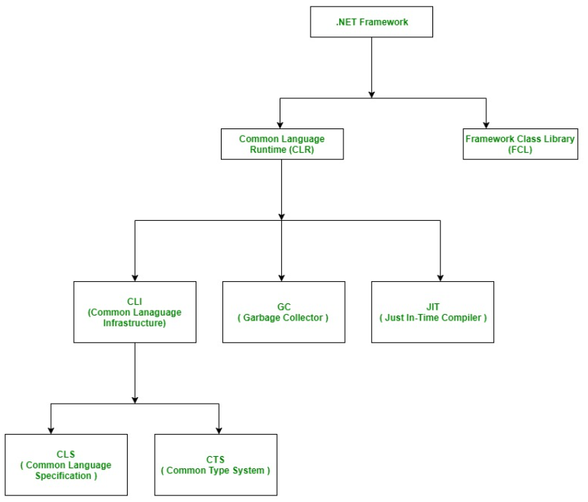

Slide 13
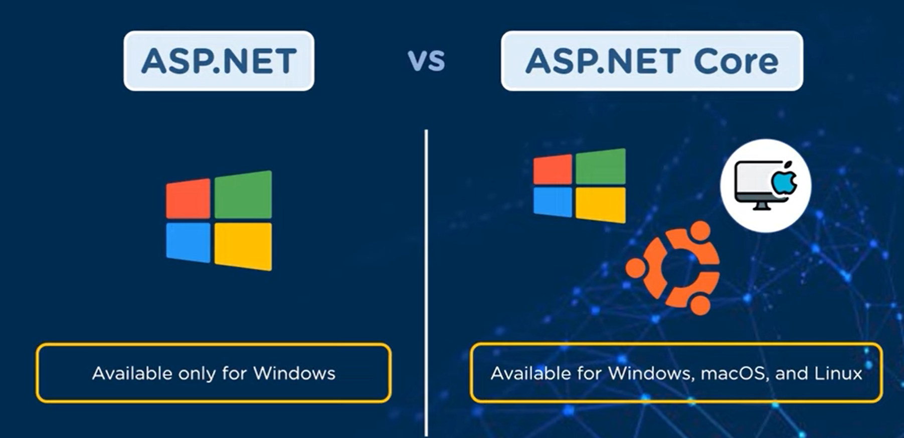
DIFFERENCE B/W ASP.NET AND ASP.NET CORE

Slide 14
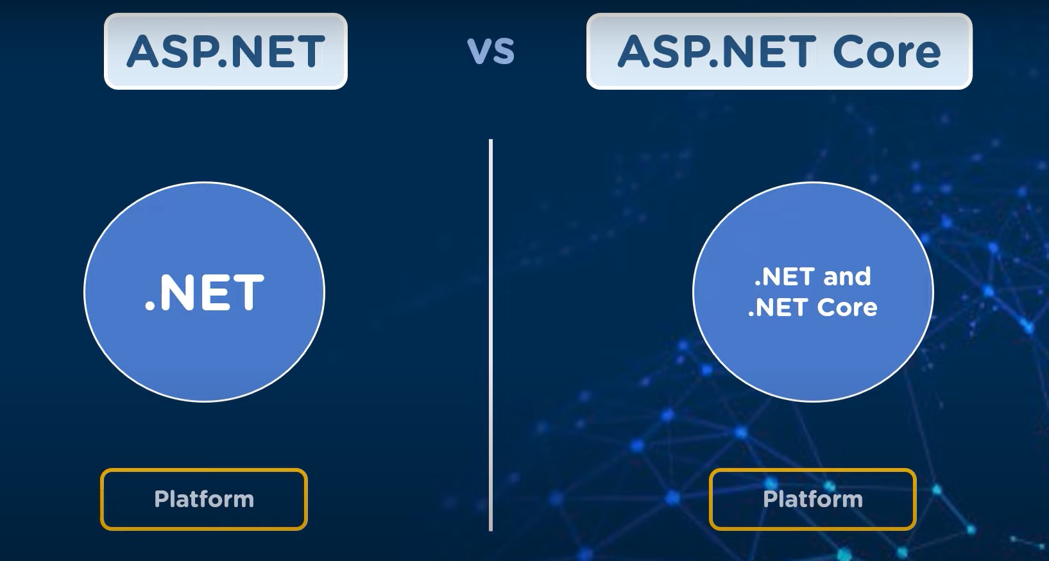
PLATFORM

Slide 15
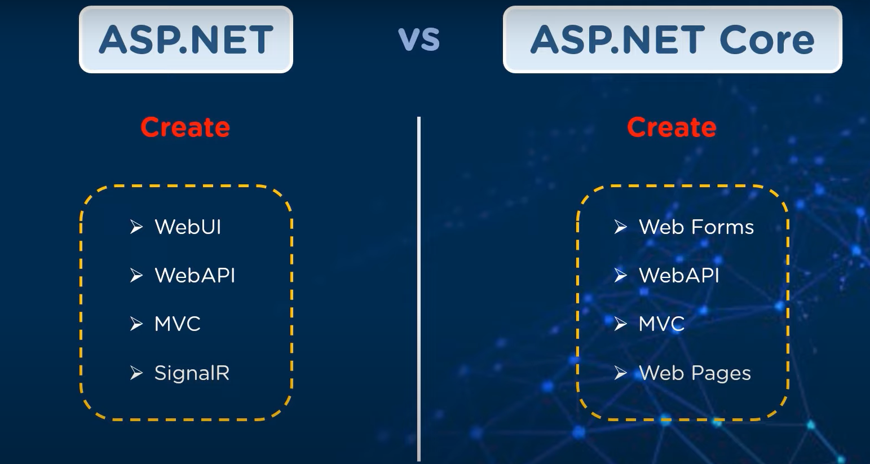
CREATION

Slide 16
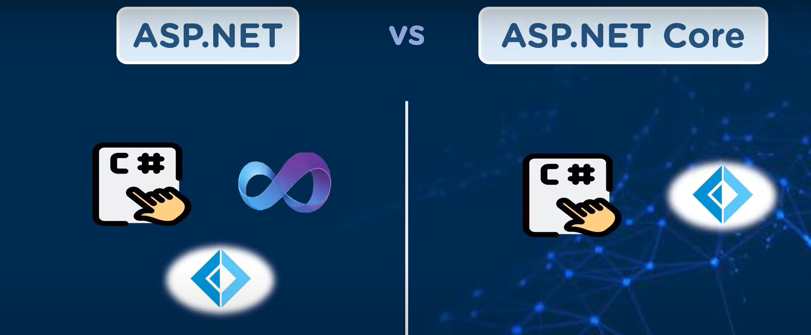
Platforms

Slide 17
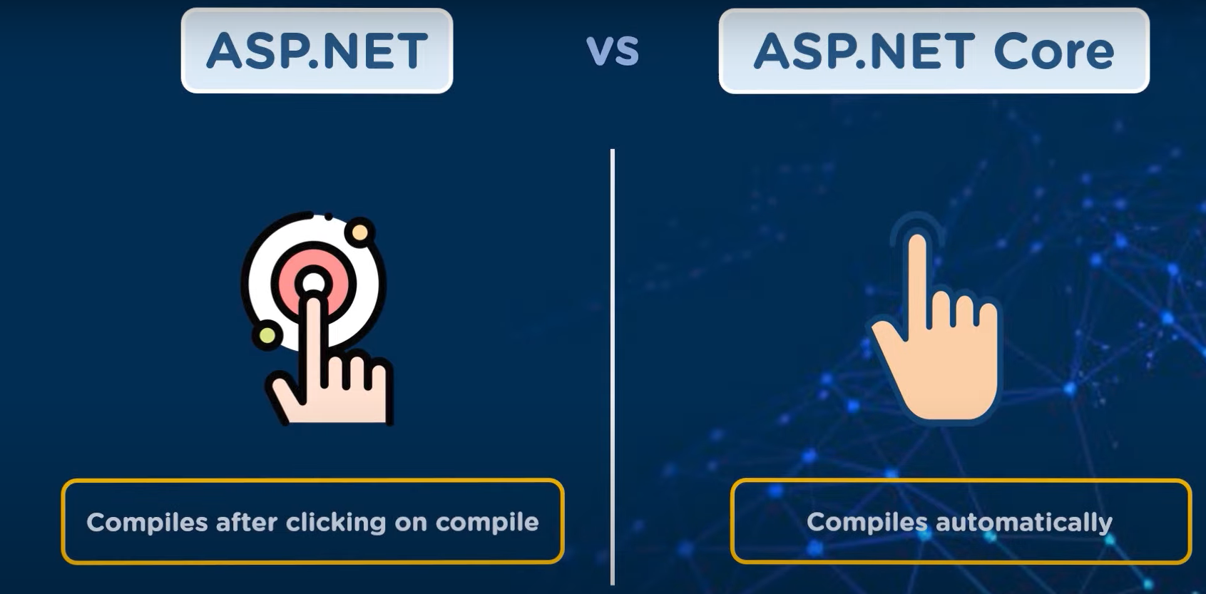
Compilation

Slide 18
Difference between .net core and .net framework
BASED ON | .NET Core | .NET Framework
Open Source | .Net Core is an open source. | Certain components of the .Net Framework are open source.
Cross-Platform | Works on the principle of “build once, run anywhere”. It is compatible with various operating systems — Windows, Linux, and Mac OS as it is cross-platform. | .NET Framework is compatible with the windows operating system. Although, it was developed to support software and applications on all operating systems.
Application Models | .Net Core does not support desktop application development and it rather focuses on the web, windows mobile, and windows store. | .Net Framework is used for the development of both desktop and web applications as well as it supports windows forms and WPF applications.

Slide 19
Difference between .net core and .net framework
Installation | .NET Core is packaged and installed independently of the underlying operating system as it is cross-platform. | .NET Framework is installed as a single package for Windows operating system.
Support for Micro-Services and REST Services | .Net Core supports the development and implementation of micro-services and the user has to create a REST API for its implementation. | .Net Framework does not support the development and implementation of microservices but it supports the REST API services.
Performance and Scalability | .NET Core offers high performance and scalability. | .Net Framework is less effective in comparison to .Net Core in terms of performance and scalability of applications.
Compatibility | .NET Core is compatible with various operating systems — Windows, Linux, and Mac OS. | .NET Framework is compatible only with the Windows operating system.
Android Development | .NET Core is compatible with open-source mobile application platforms, i.e. Xamarin, through the .NET Standard Library. Developers use Xamarin’s tools to configure the mobile app for specific mobile devices such as iOS, Android, and Windows phones. | .NET Framework does not support any framework for mobile application development

Slide 20
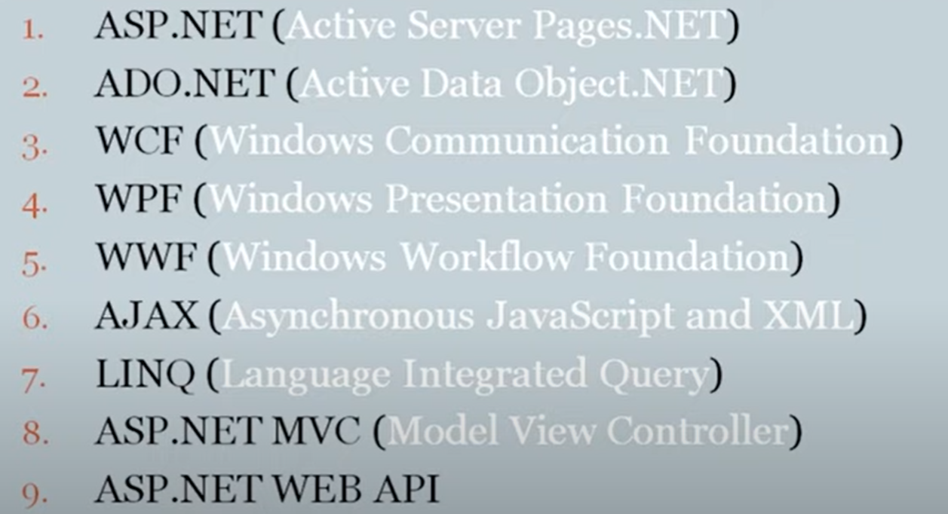
Technologies

